Slide 1

History of Video Game Sales
1980 - Now
Becca Gold
Joe Williams
Andrew Shaw
Yuji Tang
John Allison

Slide 2

Data (from Kaggle) clean up using Python
Created JSON files
Our work process
Import data & graphs using
JavaScript and D3
Created a Flask App

Slide 3
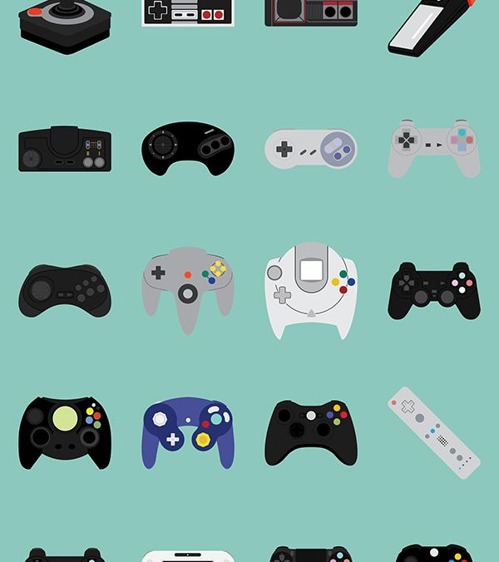
Historical trends in video games sales
By Console
Genre
Publisher
Sales/Year

Slide 4
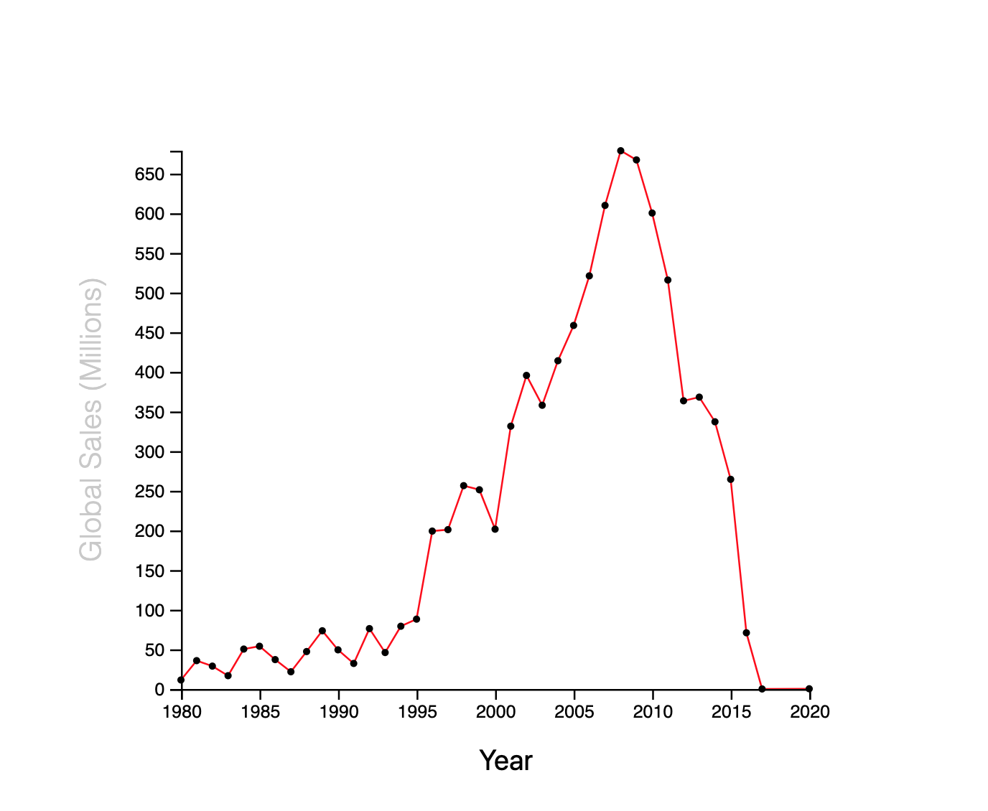
Video Game Global Sales by Year

Slide 5
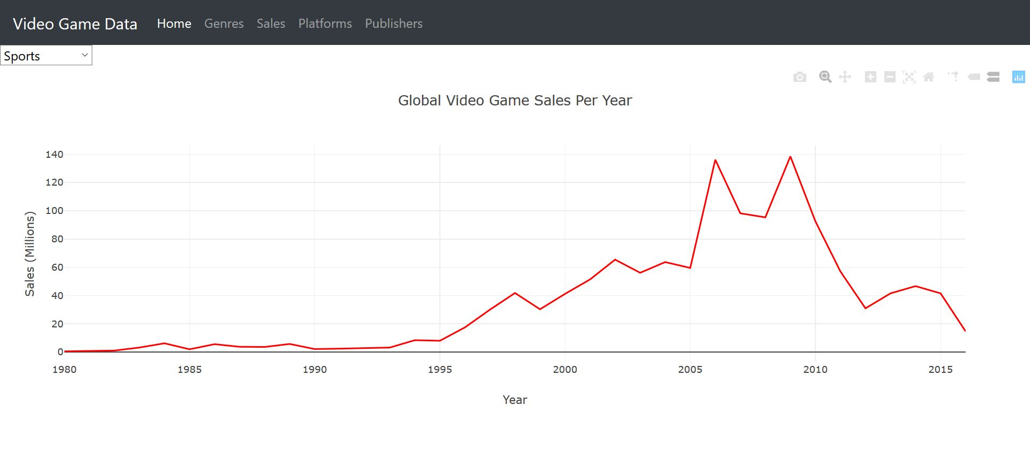
Sports Game Sales by Year (Genre)

Slide 6
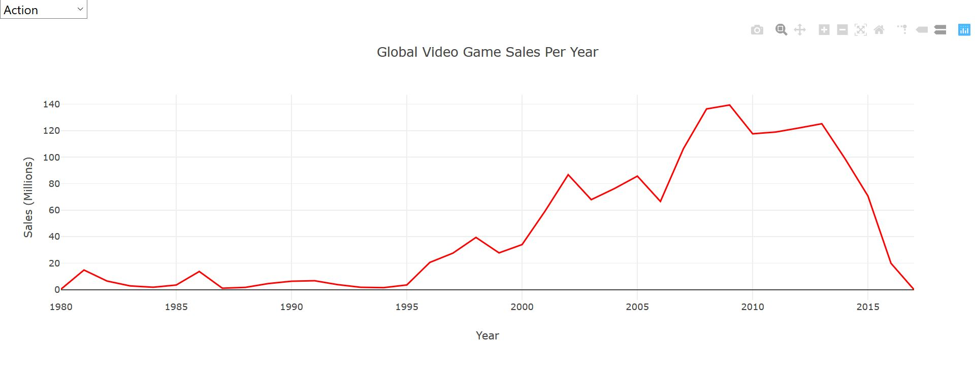
Action Game Sales by Year (Genre)

Slide 7
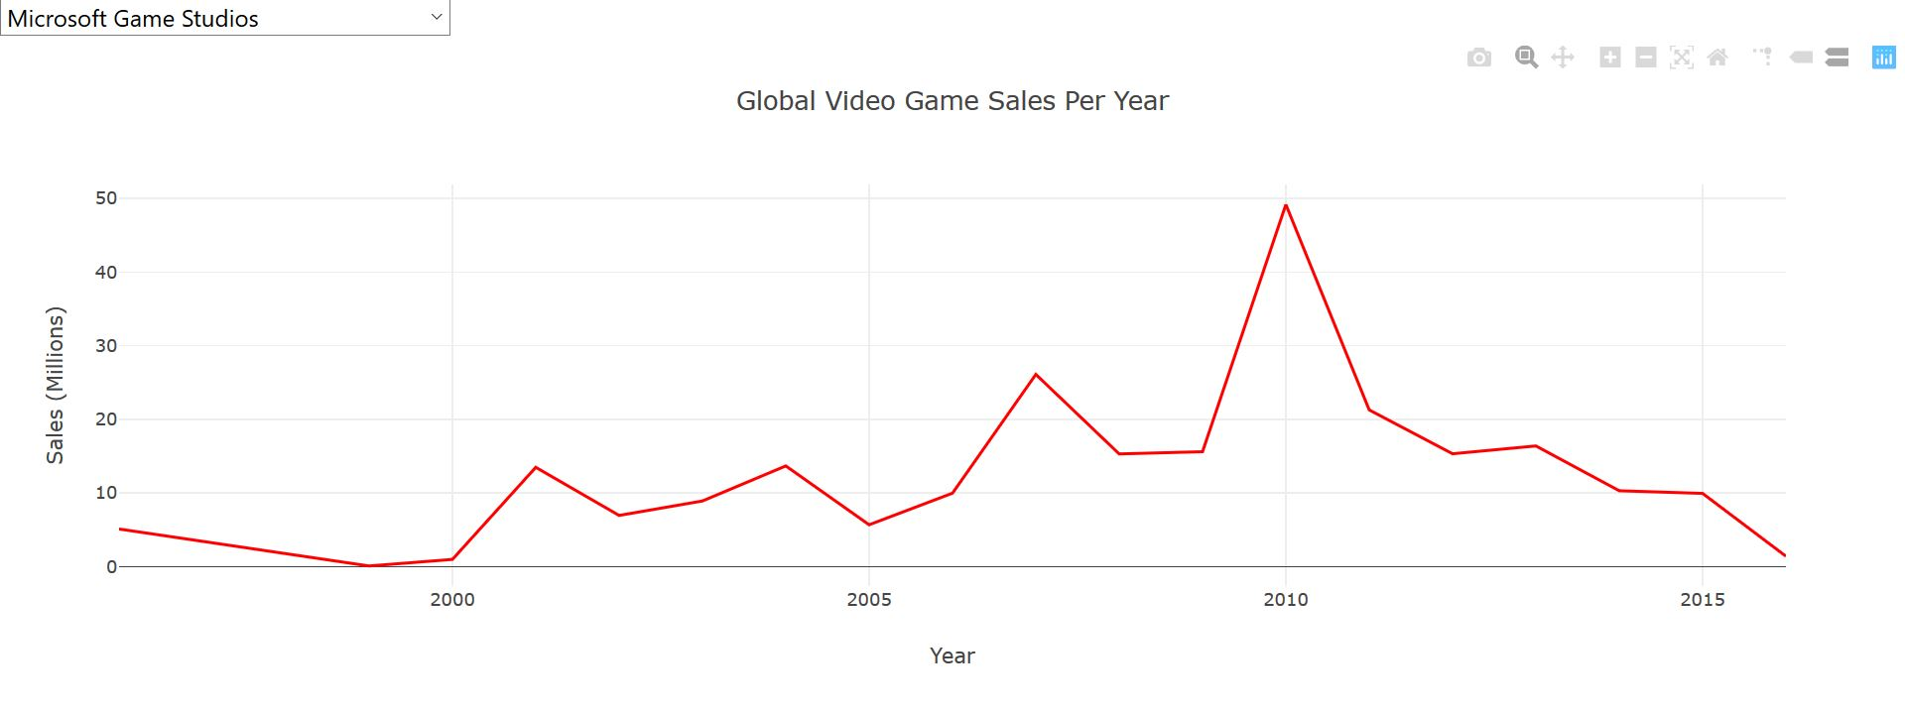
Microsoft Game Studios Sales (Publisher)

Slide 8
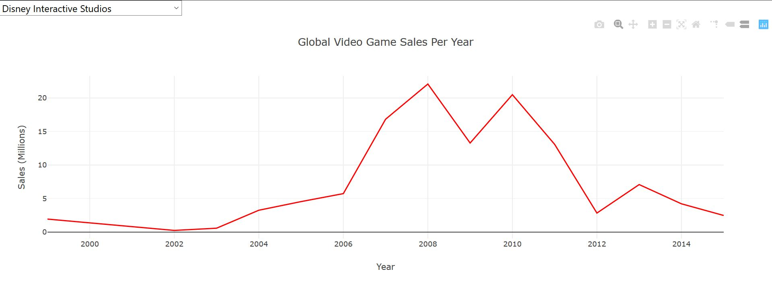
Disney Interactive Studio Sales (Publisher)

Slide 9
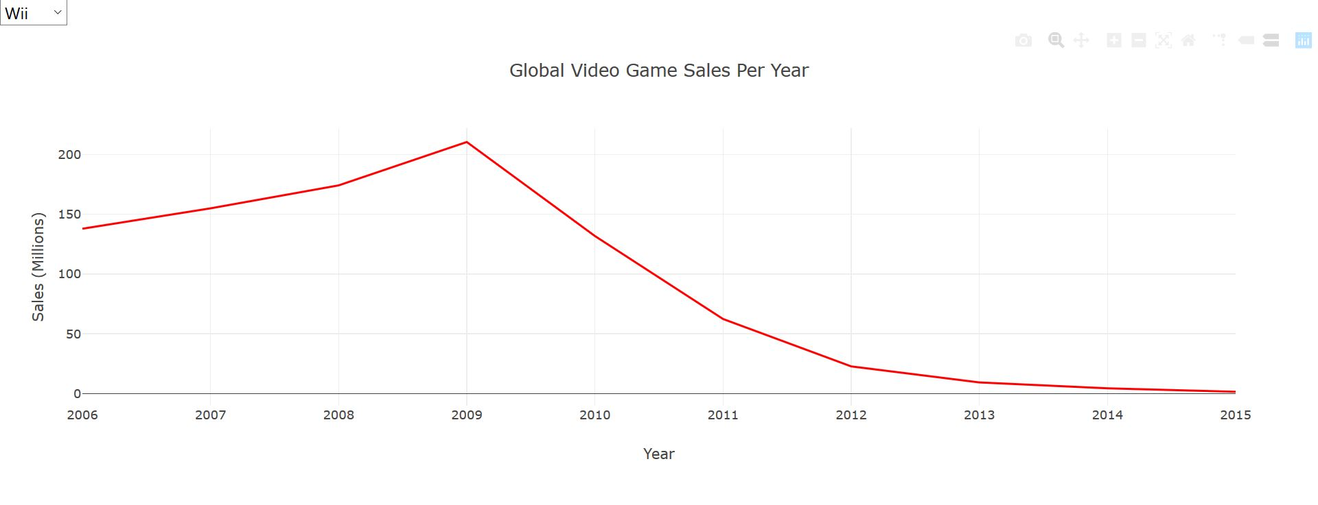
Wii Sales (Platform)

Slide 10
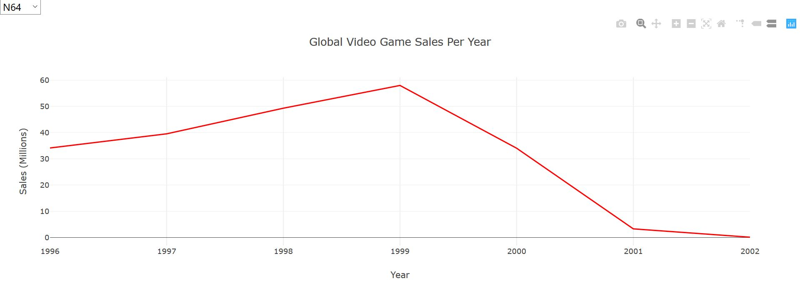
N64 Sales (Platform)

Slide 11

Trend and insight
Global Video Game sales had a significant growth between 1995 – 2008
Since it peaked, video game sales were in a decreasing trend for the last 10 years
Sports game and actions game are the highest growth genre historically
In 2008, video game sales peaked at 679M global sales
PS2 and Wii both hit 200M in sales

